Slide 1
Finding the center: correcting for compositional asymmetry in HTS datasets
Greg Gloor
U. Western Ontario
Department of Biochemistry
ggloor@uwo.ca : @gbgloor

Slide 2
Why sequence meta-*omes
Fame? 🏆
Money? 💰
Ennui ? 👻
Curiosity? 🧠
we want to understand the environment
🐙🦑🦐🦀🐡🐋🦈 vs 🐇🦌🐀🐿🦔🦒

Slide 3
Meta-transcriptomics of an ecosystem
Sequencing all the mRNA in a collection of bacteria
Information about what is being made now
Often unbalanced
Different conditions can have different taxonomic compositions
Both absolute and relative abundance of the taxa and their transcripts can change
Relative abundance does not necessarily reflect environmental reality in sequencing data

Slide 4
Bacterial vaginosis
Most common vaginal dysbiosis
H is predominantly Lactobacillus sp.
BV is mixed bag of anaerobes with L. iners
Marked asymmetry in composition
Asymmetrically sparse functions
Asymmetrically expressed functions
Group genes to functional level (SEED, KEGG)
If everything is different, then nothing is important
We must assume something is invariant

Slide 5
BV dataset
Bland-Altmann Plot
Each function is a point
Red are ‘DE’
Obviously unbalanced dataset
What assumptions do not fit?
Majority invariant?
Dispersion ~ abundance?
Counts?
Notes:
Breaks the assumptions
Note the midpoint of the dataset is off the 0 line

Slide 6
Functionalize
Macklaim & Gloor 2018. From RNA-seq to Biological Inference: Using Compositional Data Analysis in Meta-Transcriptomics. Meth. Mol. Bio.
Gloor, Macklaim, Fernandes, 2016. Displaying Variation in Large Datasets: Plotting a Visual Summary of Effect Sizes. J. of Comp. and Graph. Statistics

Slide 7
The sequencing meat grinder
Gloor et al Front. Micro. 2017

Slide 8
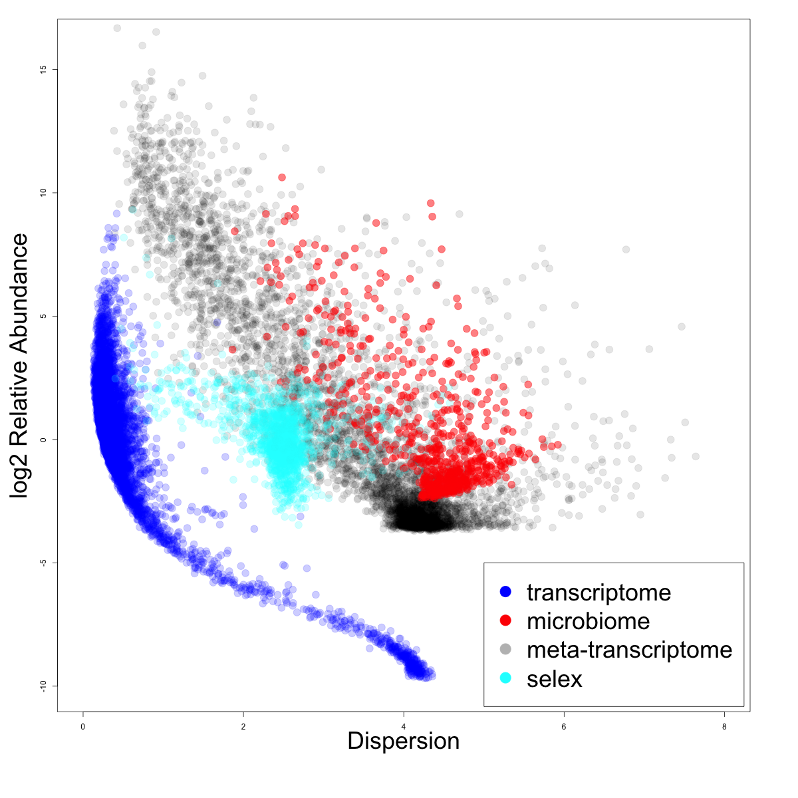
Dispersion v. rAbundance
iqlr high variance datasets
lvha low variance datasets

Slide 9
As counts
Example 100 random sample sets
range=1800-2200
range= 8000-12000
range=450-550
🐯
🐞
👽
Gloor et al Front. Micro. 2017

Slide 10
As proportions
Constant sum of 1000
Constant sum operations:
Count normalization
Rarefaction
Proportion
percentage, relative abundance
Sequencing
Gloor et al Front. Micro. 2017

Slide 11
Normalization is no help at all
Once data are on the simplex, they cannot be removed

Slide 12
Log-ratios for CoDa
Count
Sequencing
Simplex
27
853
66
740
112
216
Simplex: one fewer dimensions than variables
Problems remain regardless of dimension
clr(x) = [ log(x₁/g_{X}), log(x₂/g_{X}), … log(x_{D}/g_{X}) ]
X = [ x₁, x₂, … x_{D} ], g_{X} = geometric mean of X
Aitchison 1986. Stat. Anal. Comp Data
Pawlowsky-Glahn, 2015. Mod. Anal. CoDa
Notes:
Scale dependence - hence ‘normalization’
Correlation and covariation are unreliable
Addition and subtraction are not useful operations
Subsetting and aggregating are problematic
Sparse data is an issue

Slide 13
The 0 in the room
0 count can be real – or a non-detect
0 count is often not 0 probability to detect the count
Sequencing instruments deliver integer scaled probabilities: ‘counts’
X=[x₁,x₂,x_{i} … x_{D}] = [p₁,p₂,p_{i} … p_{D}]α ; α=ΣX; ΣP=1
x_{i} = ( P_{i} | 𝑓_{i} )α
Fernandes, PLoS ONE 2013
Gloor, Aus J. Stat. 2016

Slide 14
ALDEx2
p_{i} = 0 is strong, invalid, assumption
[P_{i} > 0, P_{i} →0]
Model the expected value
Fernandes, PLoS ONE 2013
Gloor, Aus J. Stat. 2016
EBI Hinxton

Slide 15
ALDEx2: probabilistic CoDa
Generate posterior estimates of the data consistent with the observed data and the chosen prior(s)
Dirichlet instances
clr transform instances
Calculate test values on each instance
Correct for FDR
Report the expected value of each test for all instances
Dramatically reduces false positives with little or no loss of sensitivity for essentially any seq*omics dataset
Group 1 Group 2
Fernandes, et al. 2013. PLoS ONE
Fernandes, et al. 2014. Microbiome
Thorsen, Microbiome 2016
Notes:
Many more fragments than we can count

Slide 16
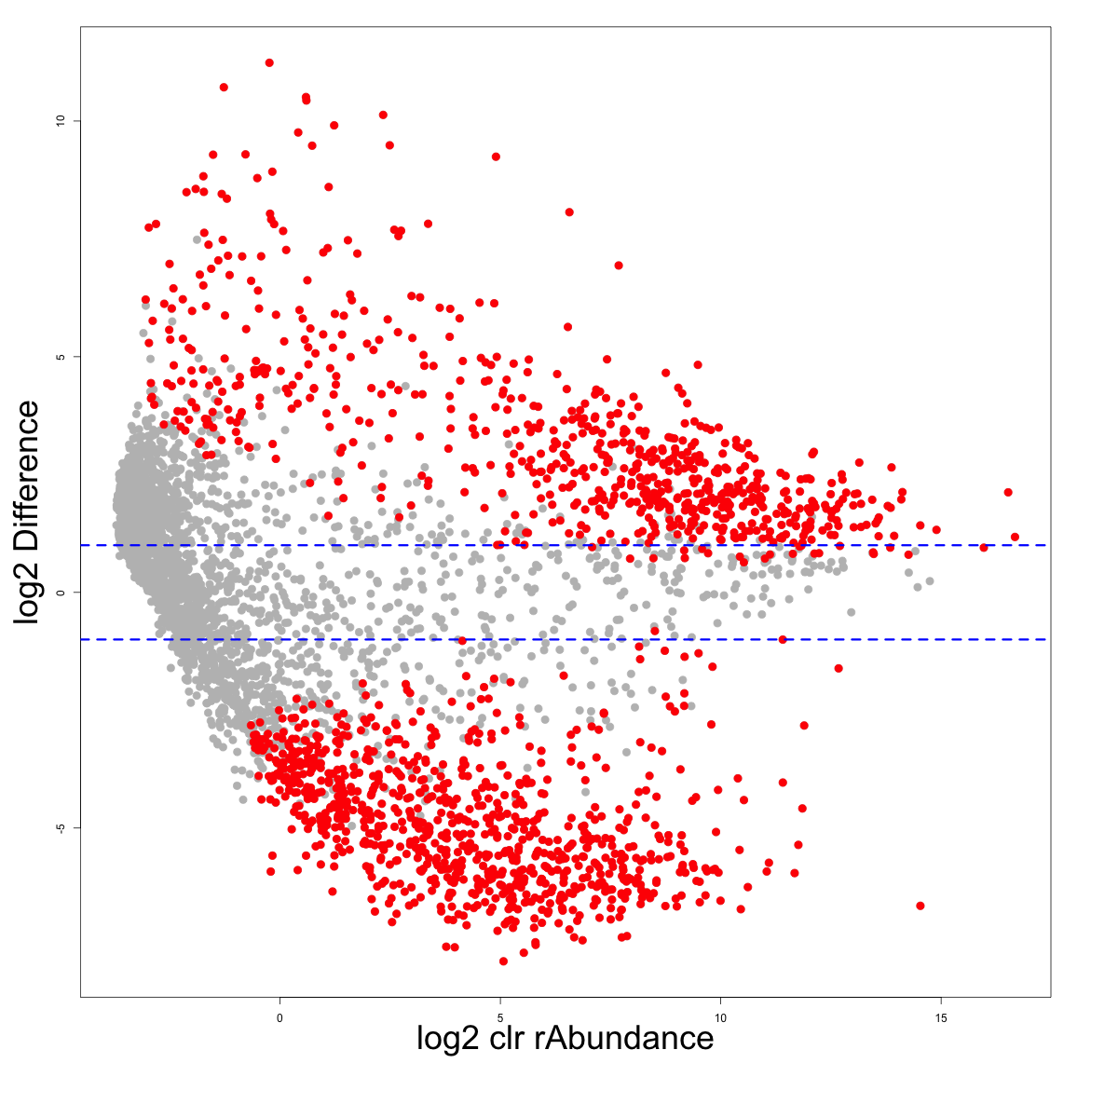
So let’s try probabilistic CoDa
ALDEx2

Slide 17
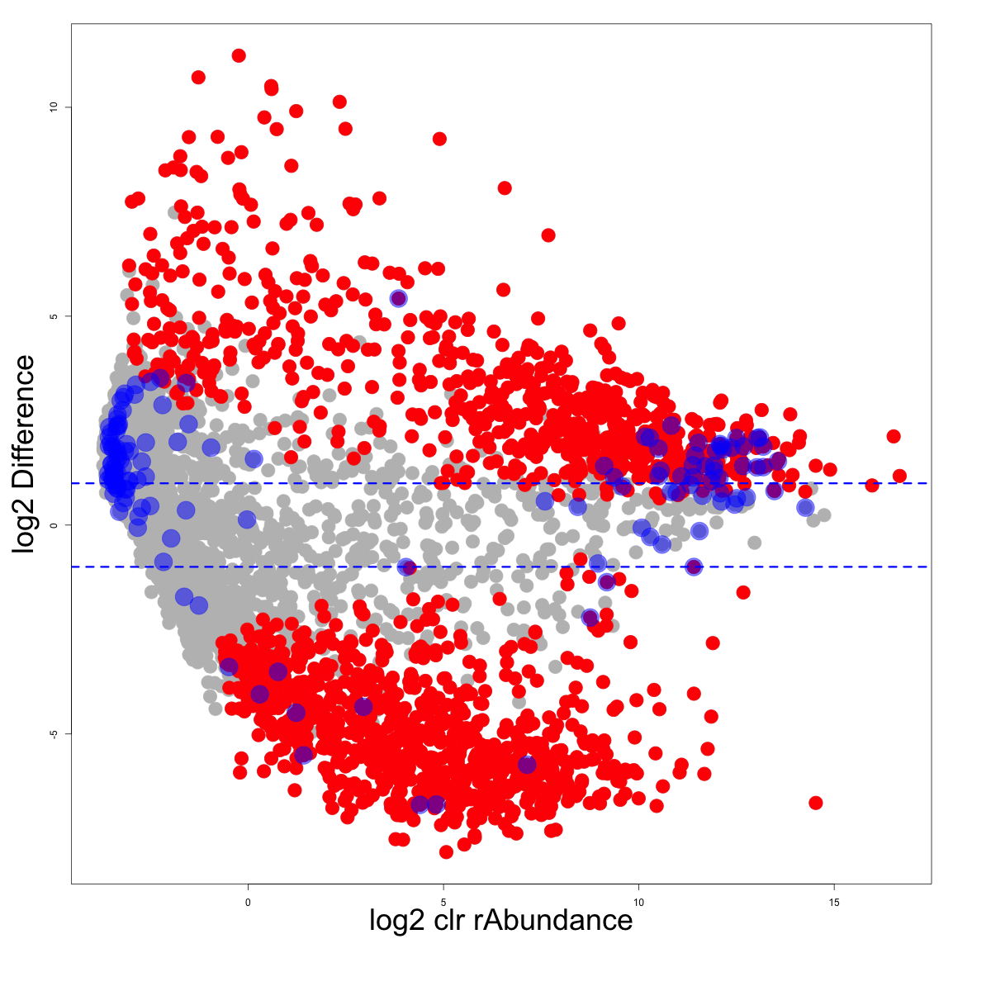
Housekeeping genes should be invariant

Slide 18
Strategies to center the data
All
One
Robust midpoint variance
Low variance, high abundance
Median

Slide 19
Properties in simulated data

Slide 20
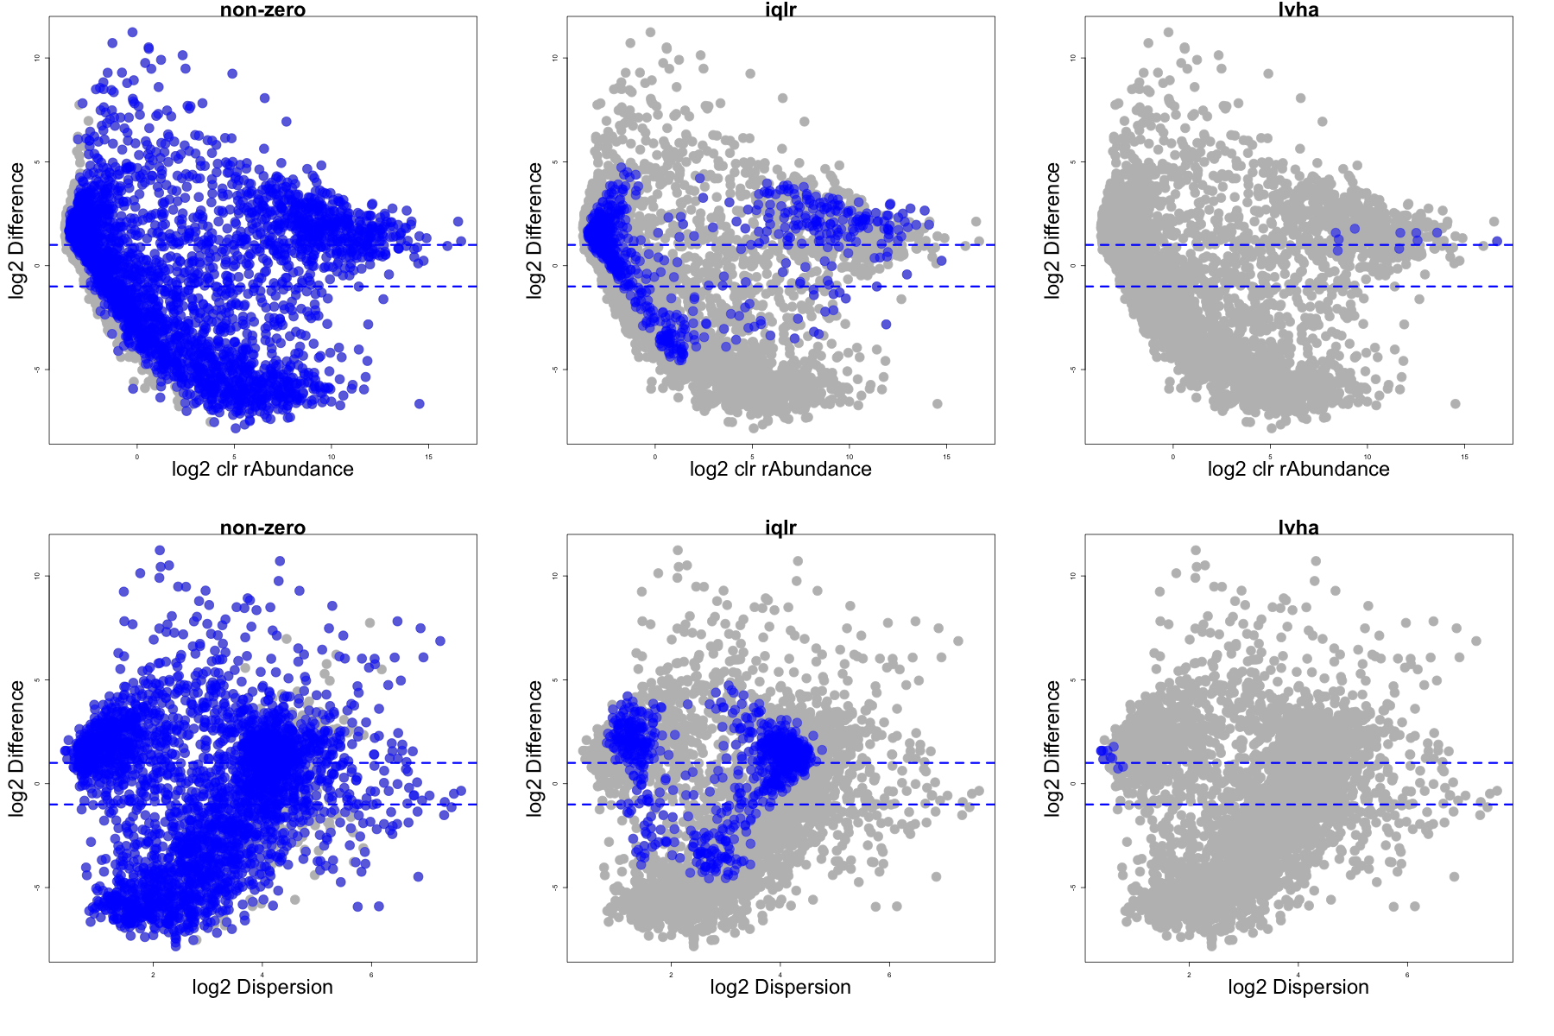
In meta-transcriptome data

Slide 21
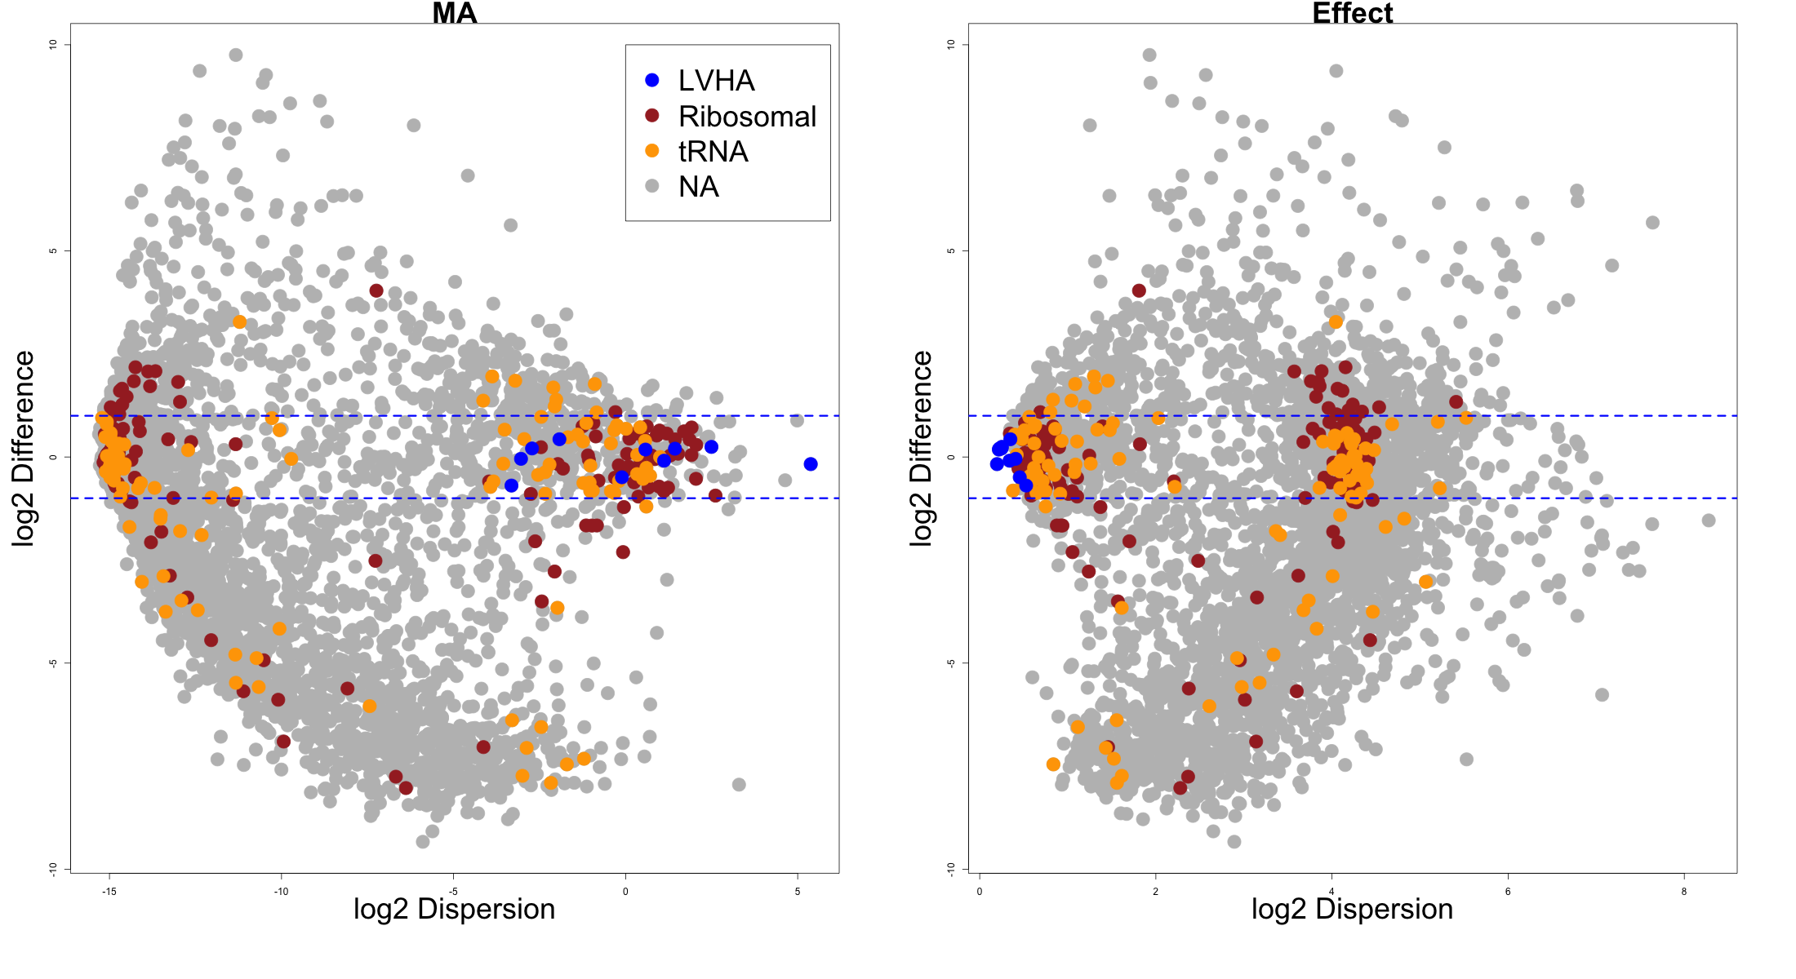
We have centered the housekeeping genes

Slide 22
Back to why we do this
Macklaim, Macmillan unpublished
Macmillan Sic Rep 2015

Slide 23
Functions
Denom
Cell division protein MraZ
D-tyrosyl-tRNA(Tyr) deacylase
Deoxyuridine 5'-triphosphate nucleotidohydrolase (EC 3.6.1.23)
DNA ligase (EC 6.5.1.2)
FIGfam135315: Iojap-related protein
LSU ribosomal protein L3p (L3e)
Membrane-associated zinc metalloprotease
Peptide chain release factor 3
Ribosomal large subunit pseudouridine synthase B (EC 4.2.1.70)
Signal peptidase I (EC 3.4.21.89)
Transcription-repair coupling factor
Translation elongation factor Ts
tRNA nucleotidyltransferase (EC 2.7.7.21) (EC 2.7.7.25)
Tryptophanyl-tRNA synthetase (EC 6.1.1.2)

Slide 24
Four groups
BV
core
Core = housekeeping
BV = biosynthesis/TCA
H = aa/sugar
BV1 = …
H
BV-1

Slide 25
Distinguishing features

Slide 26
Reference sequence

Slide 27
BV only

Slide 28
Apply to a meta-analysis
Original dataset
Vaginal swab – treatment naïve (S)
Vaginal wash – BV treatment naïve, H post-metronidazole
Deng et al. mSphere 2018
Annotate reads using same pipeline
Diamond/SEED
Keep functions shared by both

Slide 29
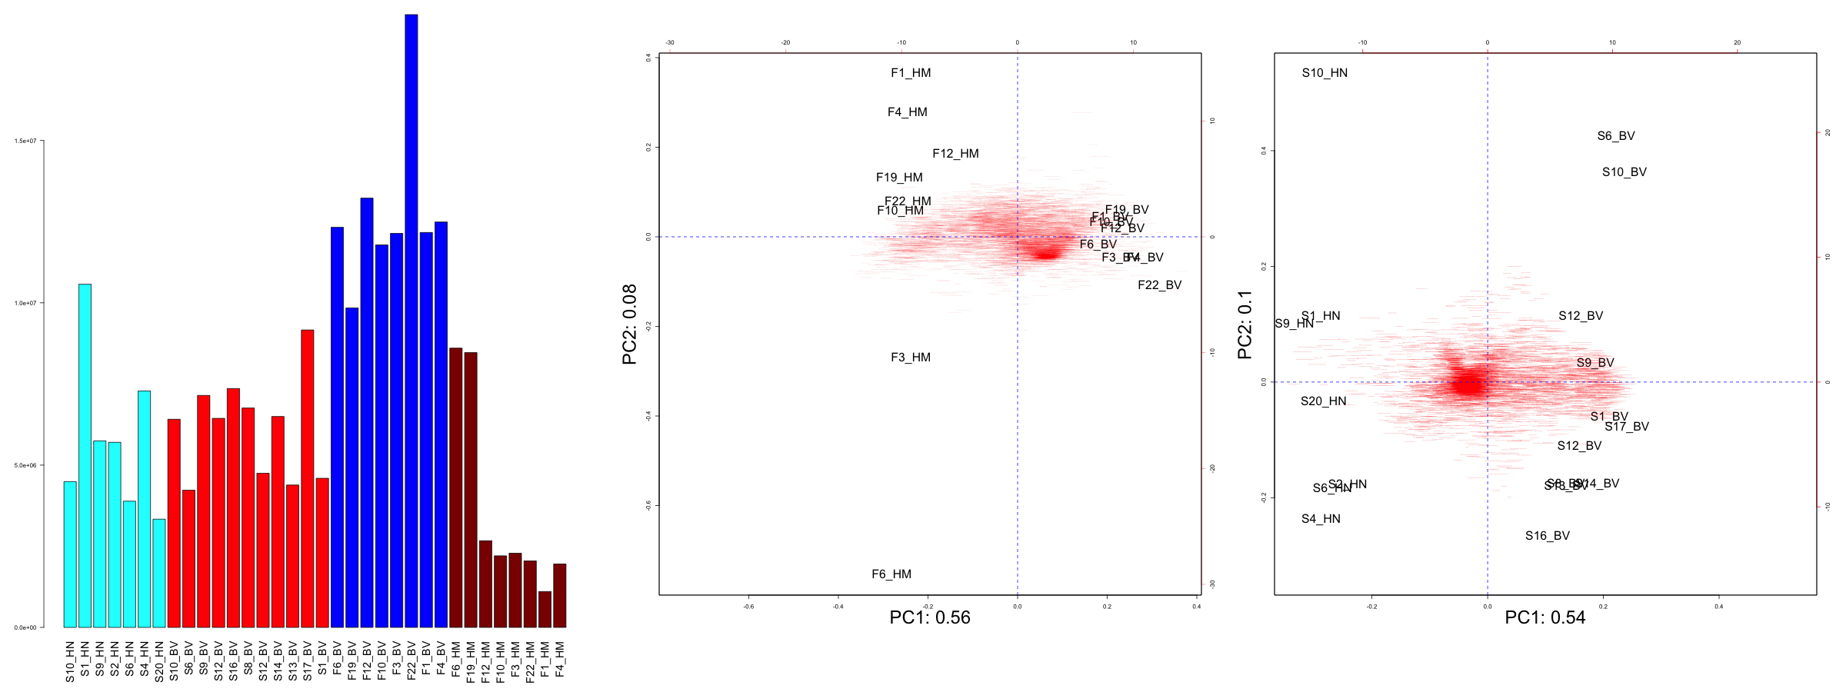
Data characteristics
Fluid samples
Swab samples
Deng et al. mSphere 2018
Maclaim Meth. Mol.. Biol 2018

Slide 30
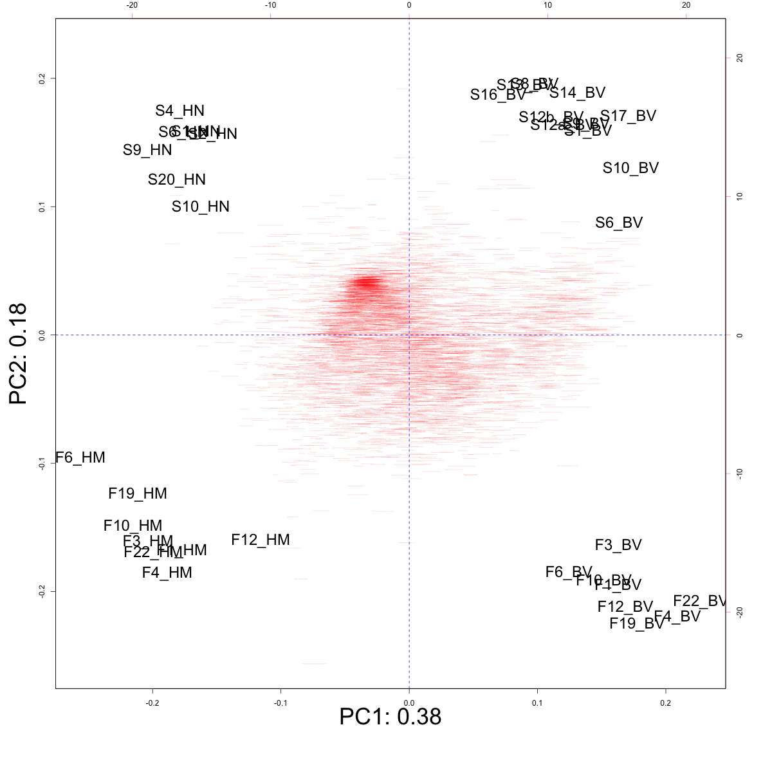
The datasets are distinct
H
BV
Swab
Fluid

Slide 31
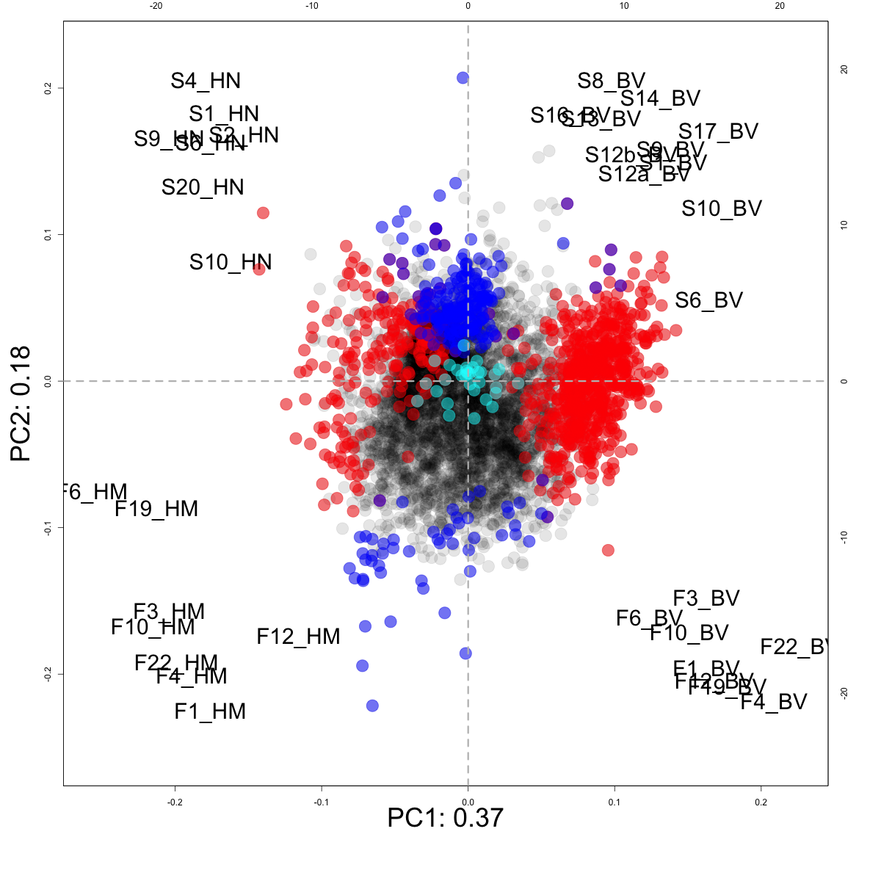
ALDEx2: E(glm)
Not different
LVHA
S vs F
H vs BV

Slide 32
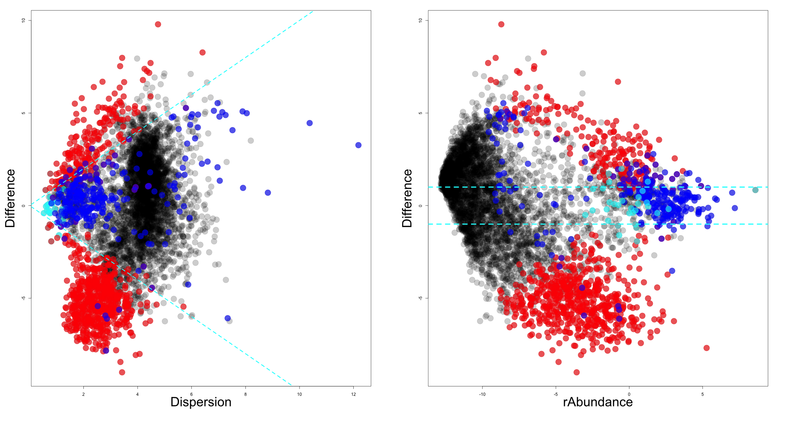
Effect BA
Not different
LVHA
S vs F
H vs BV

Slide 33
Conclusions
Asymmetry in datasets is surprisingly common
Meta-transcriptomes are hard
Can at least get reproducible answers across datasets
Proper centering is needed to prevent non-sensical answers
Choosing the proper centering method depends on the var-abun relationship

Slide 34

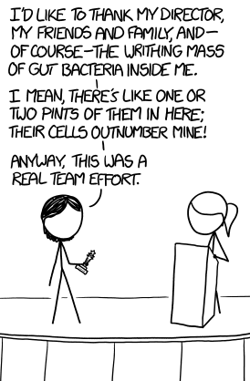


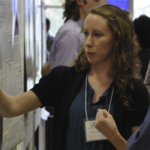




Andrew
Fernandes
Jean
Macklaim
Vera Pawlowsky-Glahn
Juan Jose Egozcue
Justin Silverman
philr
Tom Quinn
propr
Gregor Reid
Jeremy Burton
Daniel Giguere

